Slide 1

IoT Group N
Android application+ CNN model+ Respeck
Group member: Chenxi Yang
Pengcheng Jin
Yongjian Liu

Slide 2
The architecture of implementation
CNN Model
App design
Server
User interface
Motion detection
User authenticate
Cloud database(History data)
Sitting reminder
Falling warning
Software

Slide 3
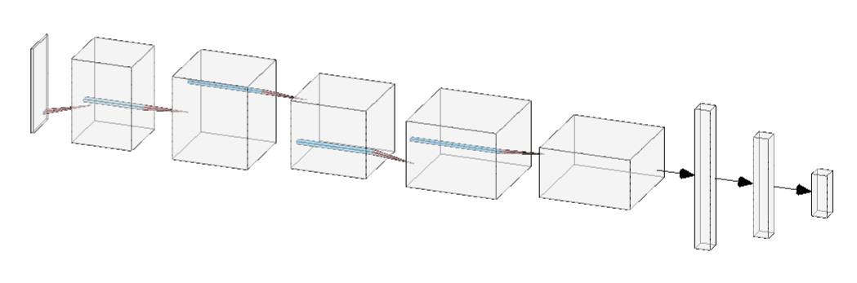
Models
Convolution
Convolution
Max-Pool
Convolution
Max-Pool
Input (50, 6)
BatchNorm
Conv (filter 16, kernel 3)
BatchNorm
ReLU
Conv (filter 32, kernel 3)
BatchNorm
ReLU
Max-Pool (2)
Conv (filter 64, kernel 3)
BatchNorm
ReLU
Max-Pool (2)
Flatten
Dense (ReLU)
Dense (softmax, 7)
Flatten
Dense
Dense
Total params: 73,359
Training set 94.4%
Test set 94.0%

Slide 4
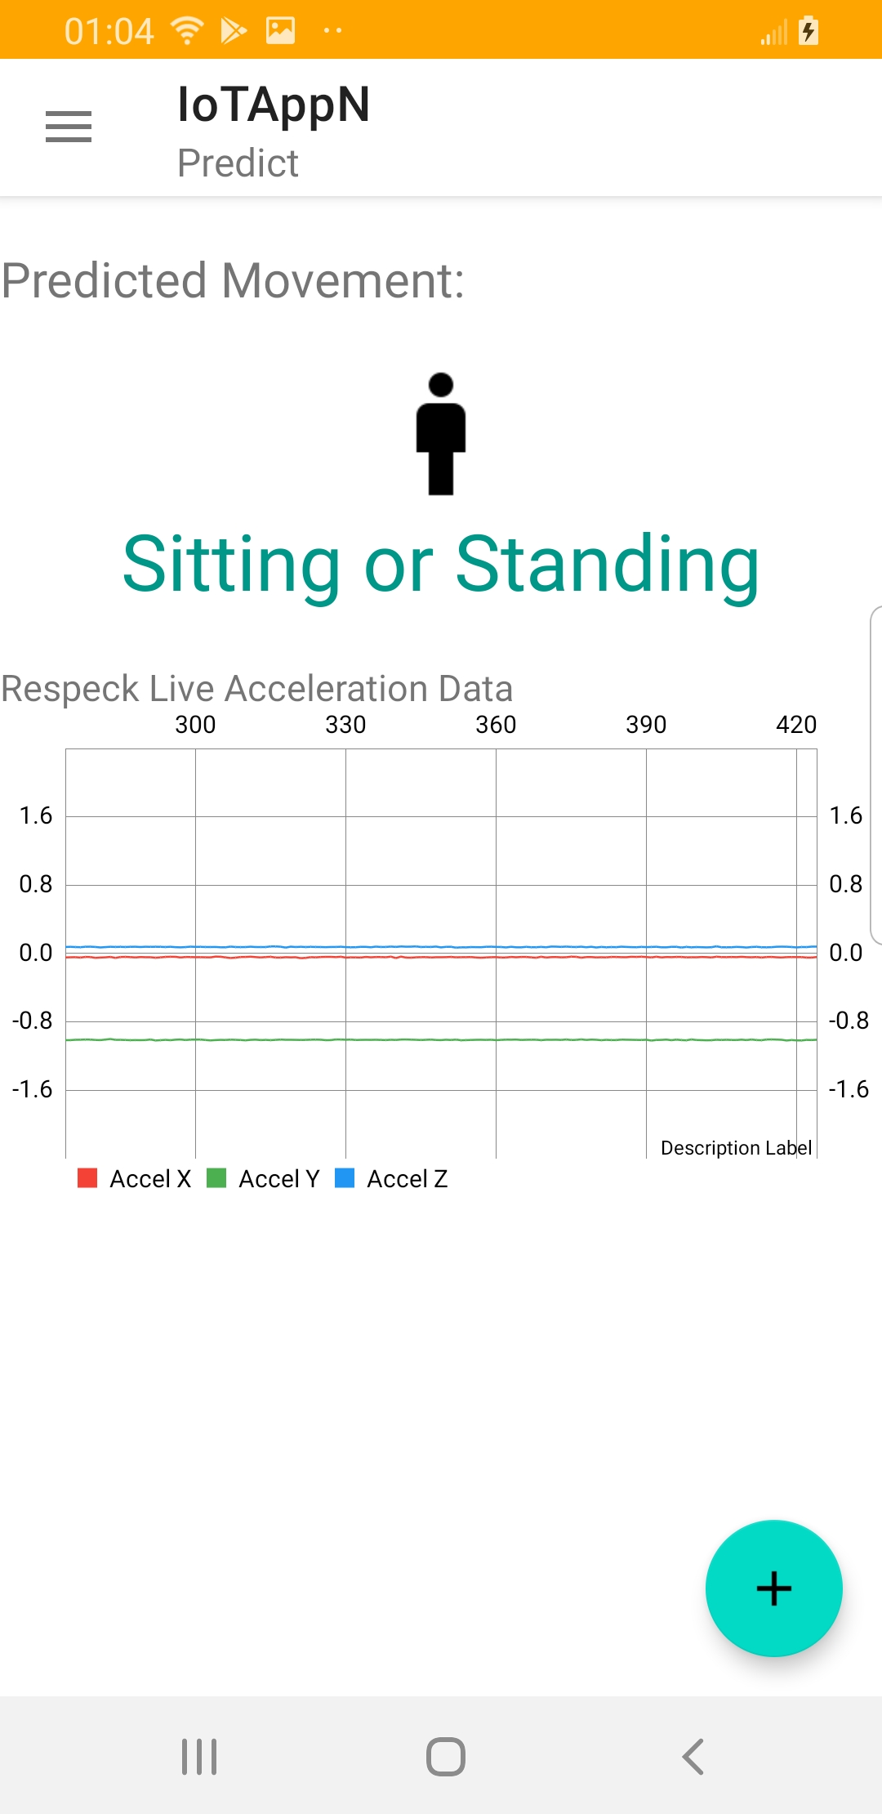
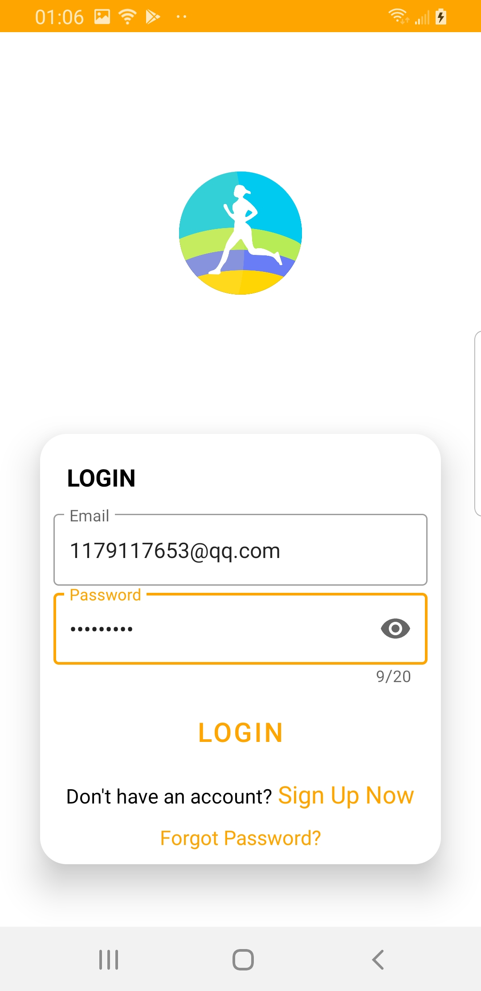
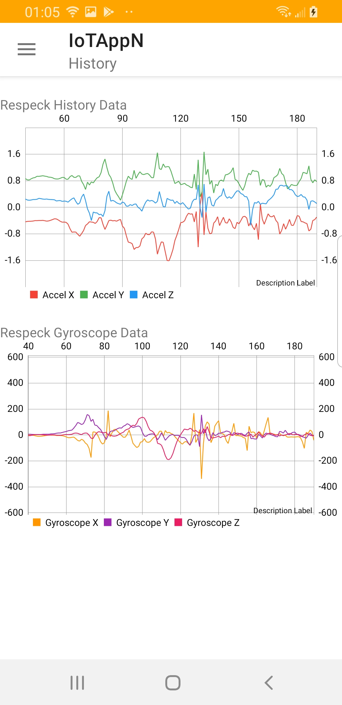
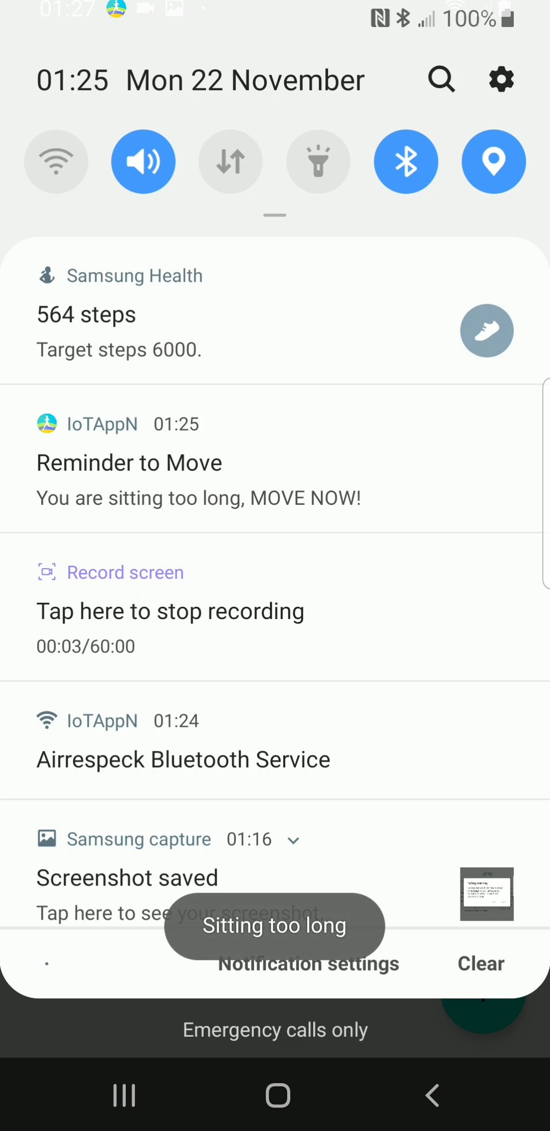
App design
Five Main Function
1. Motion detection
7 classes(CNN trained)
Falling, Lying, Descending, Climbing stairs,
Walking, Sitting, Running
2. Account authentication(registered, reset password)
Based on the Google Firebase (email address, password)
3. History data showing
Data in Cloud(JSON tree)
4. Sitting Reminder
Reminder sitting time too long
Customize own Max sitting time

Slide 5
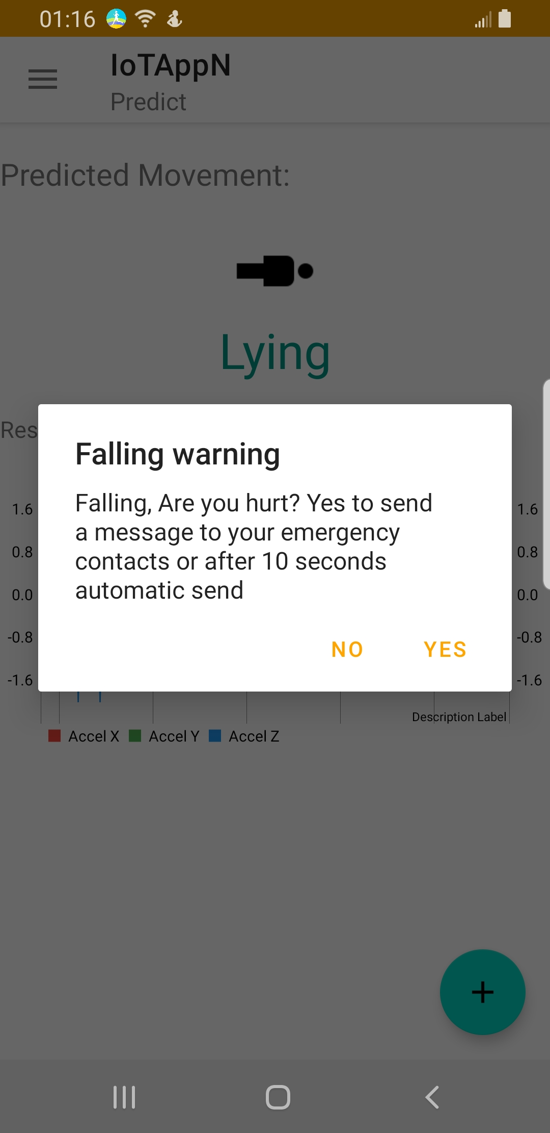

5. Falling Warning
Customize Emergency Contact
Auto Call Emergency Contact
when falling

Slide 6
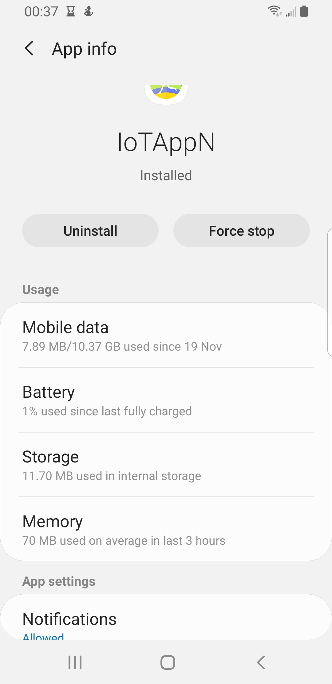
Performance Test
1. Accuracy
Training set 94.4%; Test set 94.0%
2. Communication latency
0-1 seconds
3. Power consumption
75.68mAh /10min
4. Cellular data consumption
7.89MB/10min
5. CPU cycles
No more than 20% of total 2.36GHZ
6. Memory usage
Average RAM usage 70MB
ROM: 11.7MB

Slide 7
Conclusions and reflections
Advantage:
High accuracy
User authentication (Cloud)
Hstory data is stored in NoSQL Cloud database
Falling warning
Customize the Max Sitting reminder time & Emergency Contact
Disadvantage:
Only 7 classes
Model stored in the device, not cloud

Slide 8
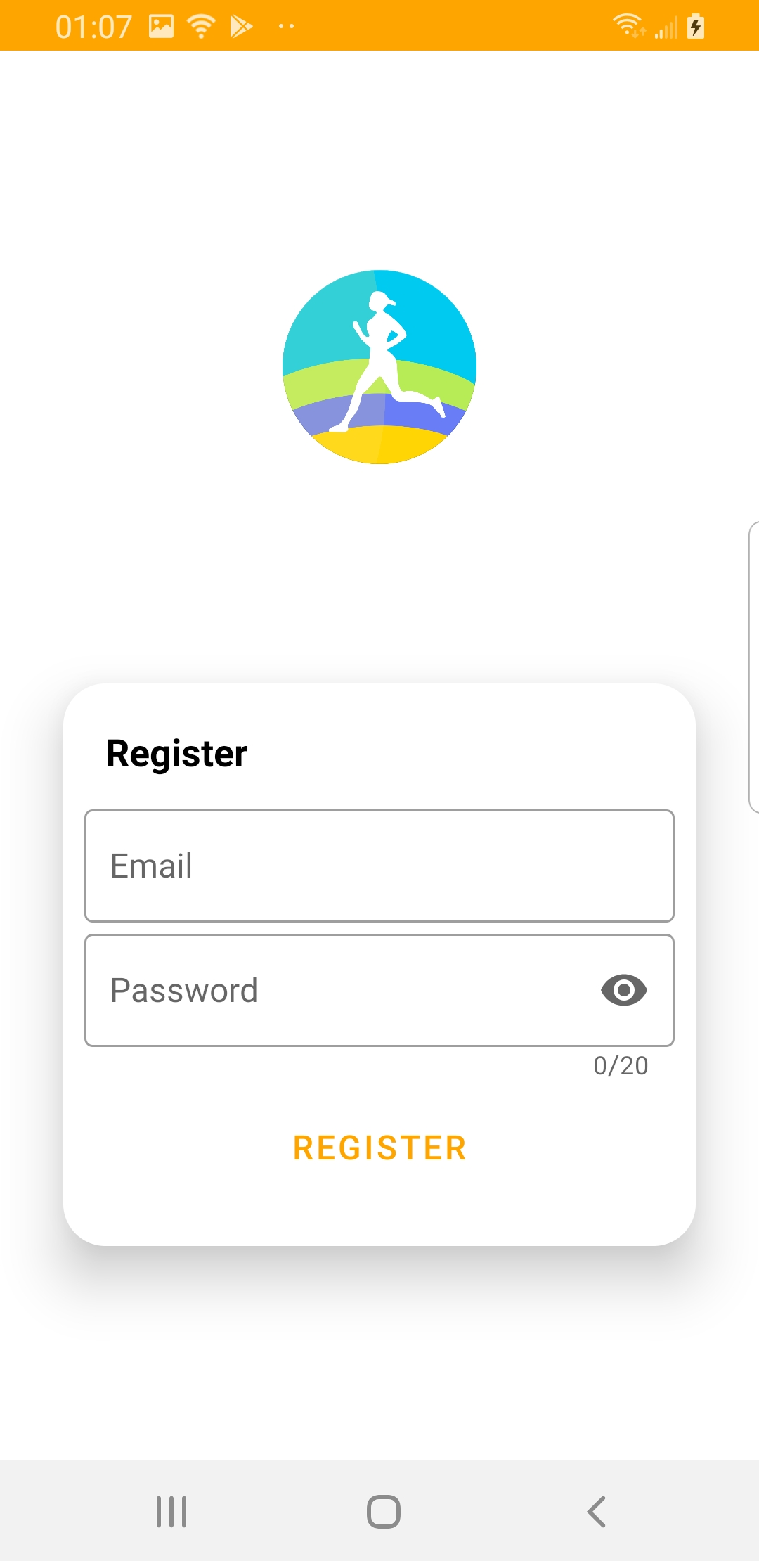
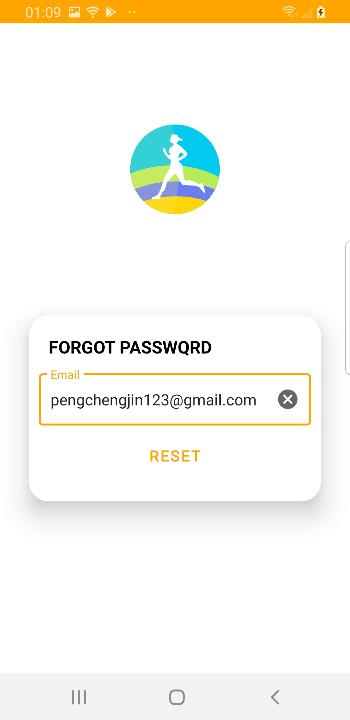
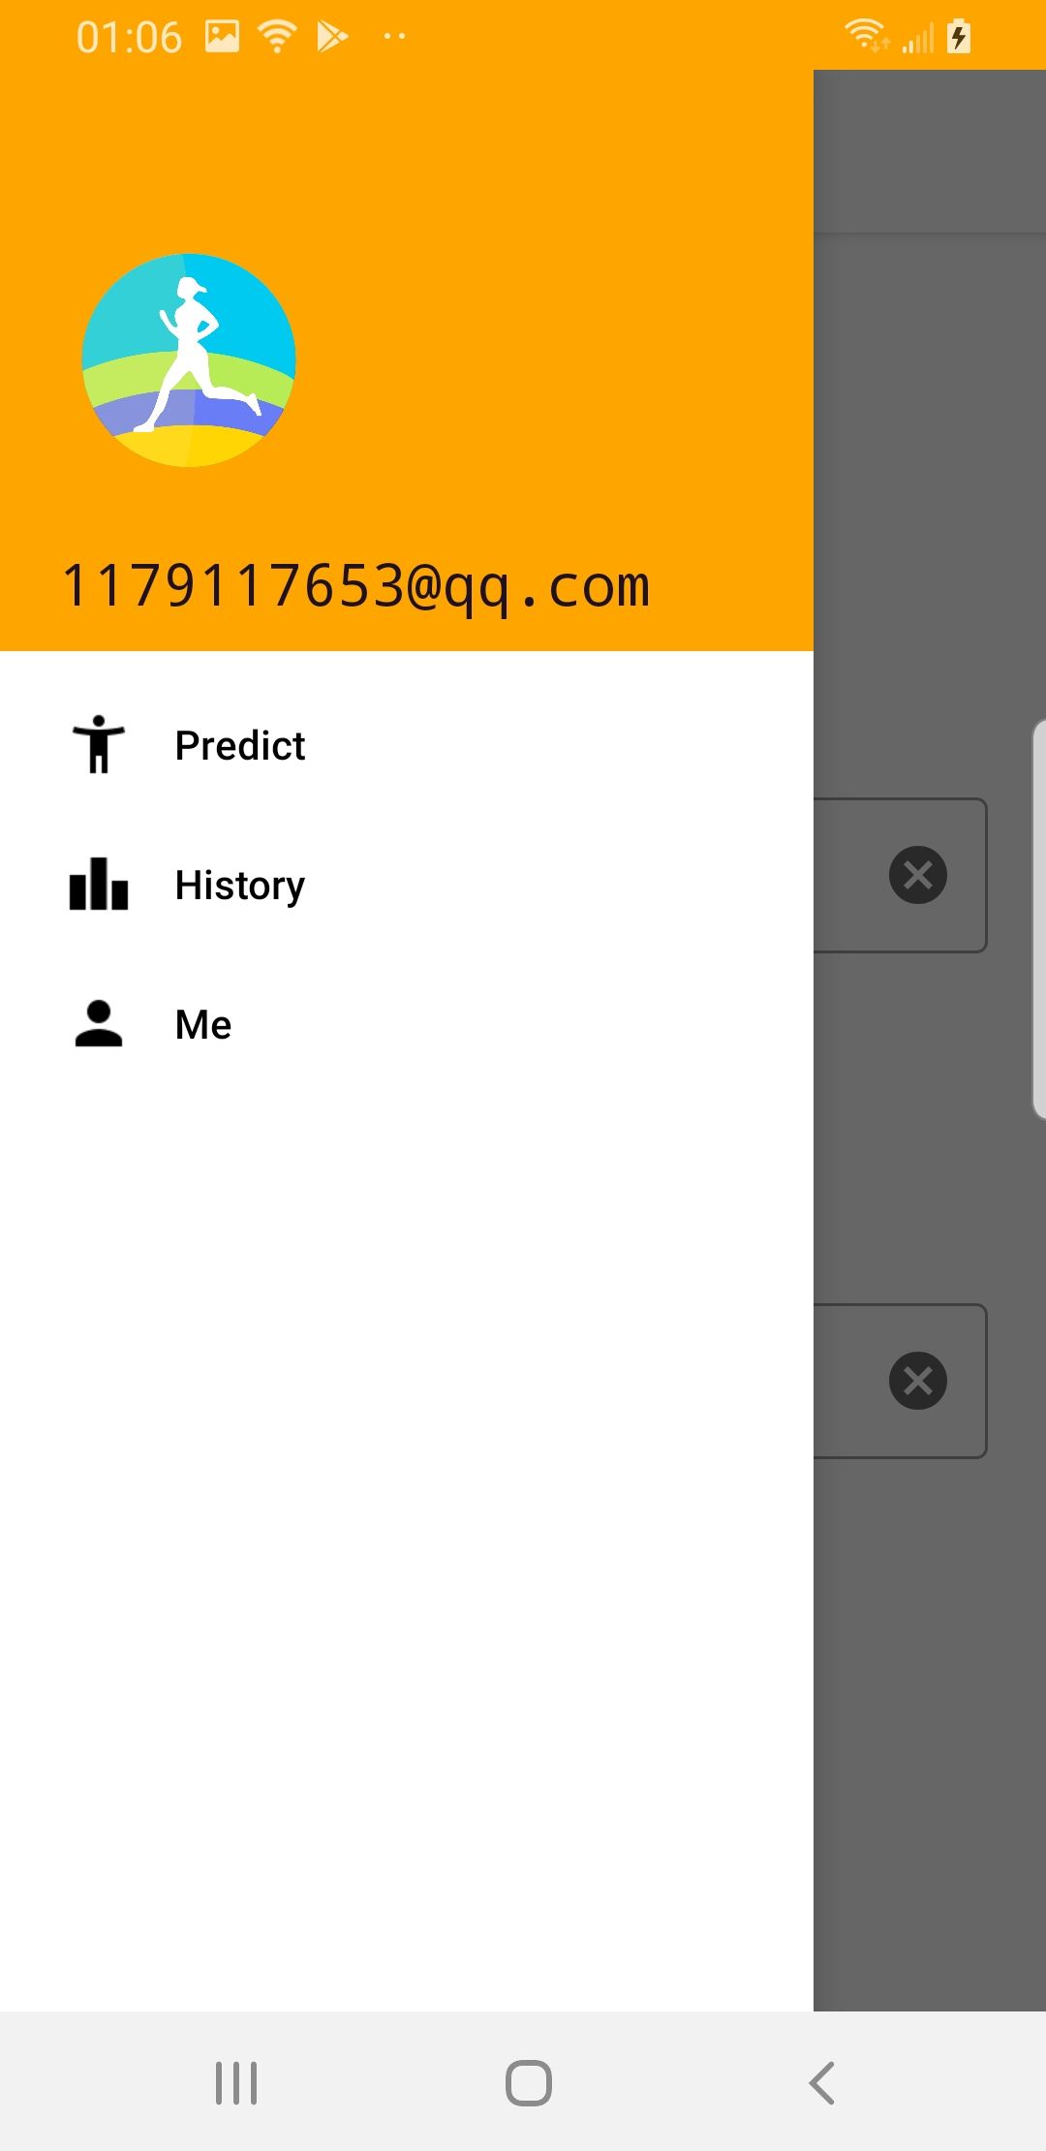
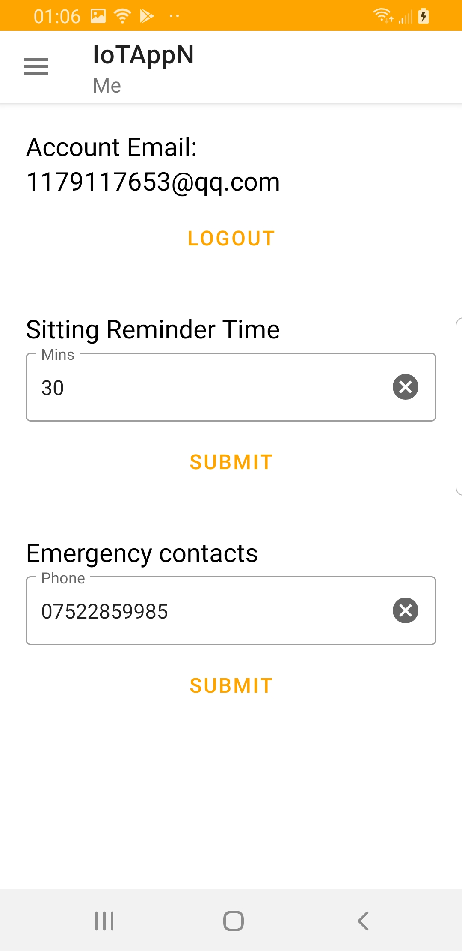

Appendix: App screen shot

Slide 9
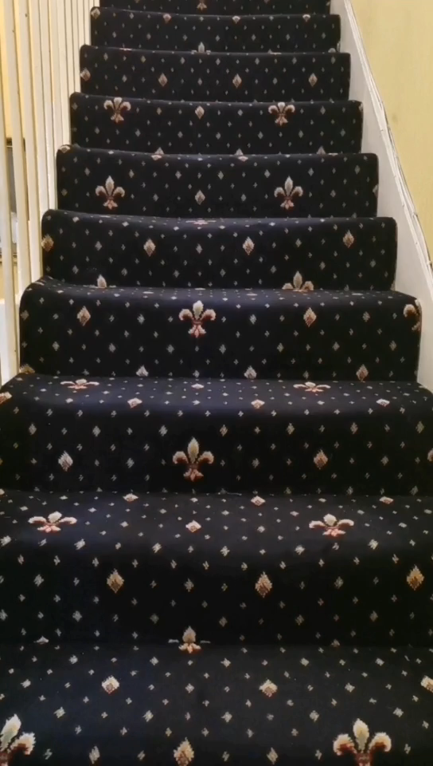
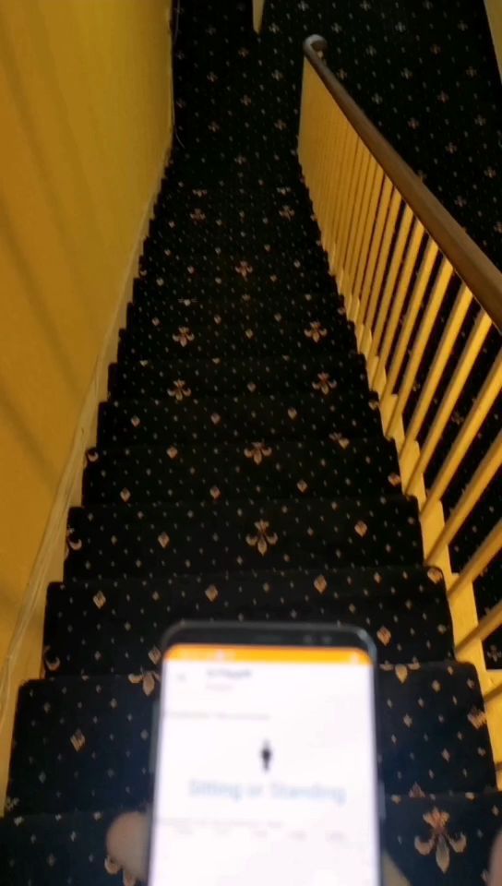
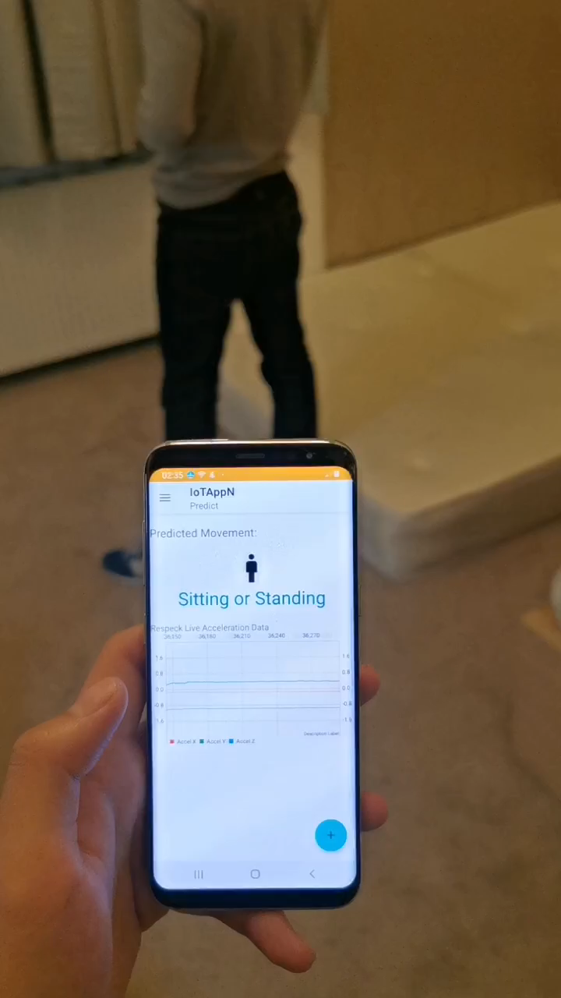
Appendix: Climbing, Descending, Falling, Lying

